Slide 1
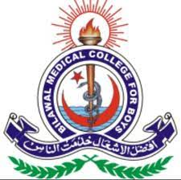
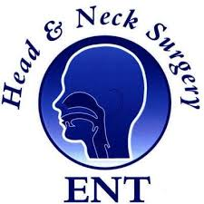
DR. ISHFAQ AHMED ARAIN MBBS,FCPS Consultant ENT Head & Neck Surgeon Assistant professor Bilawal Medical Collage Hospital LUMHS Jamshoro- Hyderabad.

Slide 2
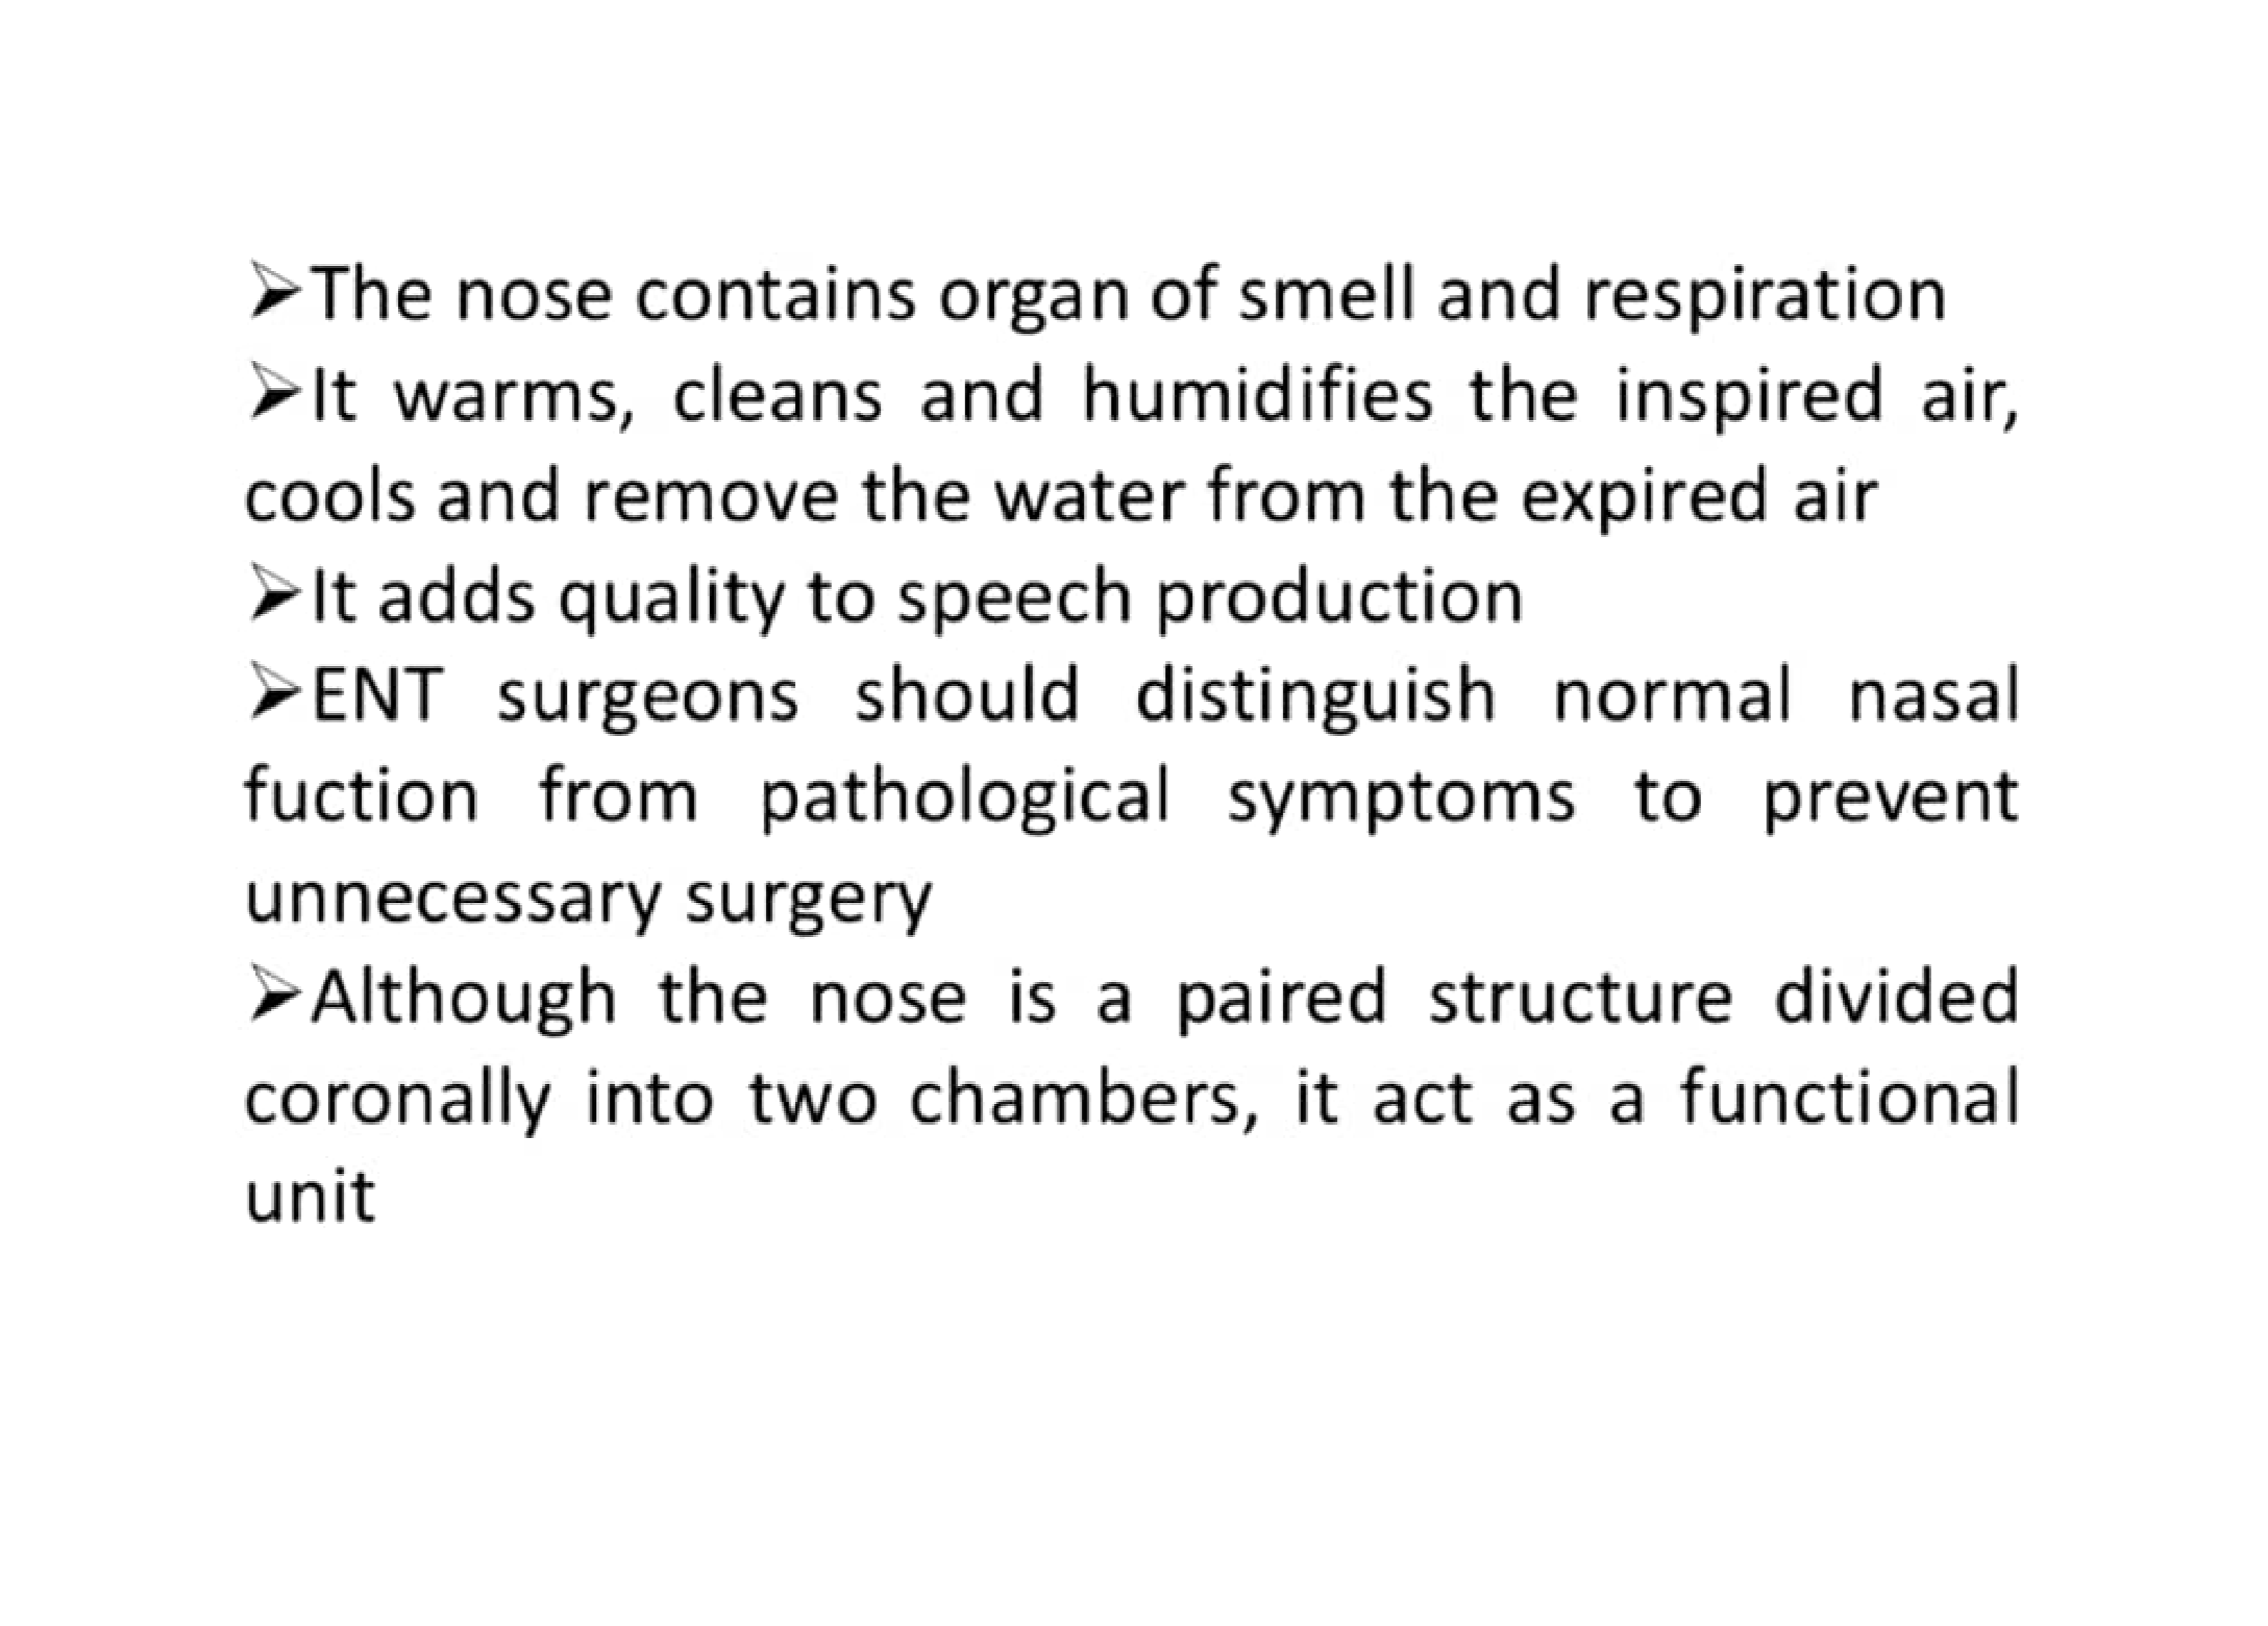
Physiological Of Nose

Slide 3
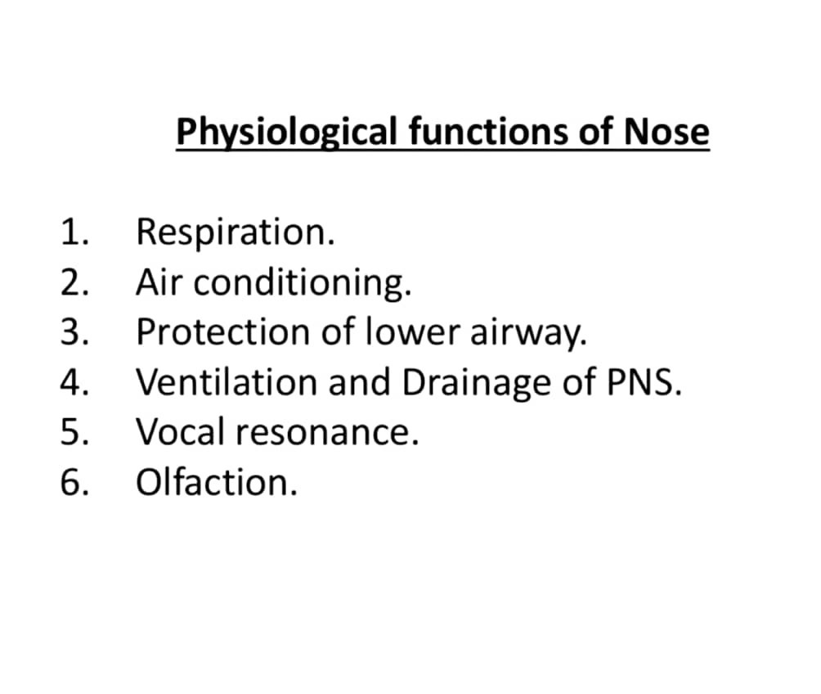
Functions Of Nose

Slide 4
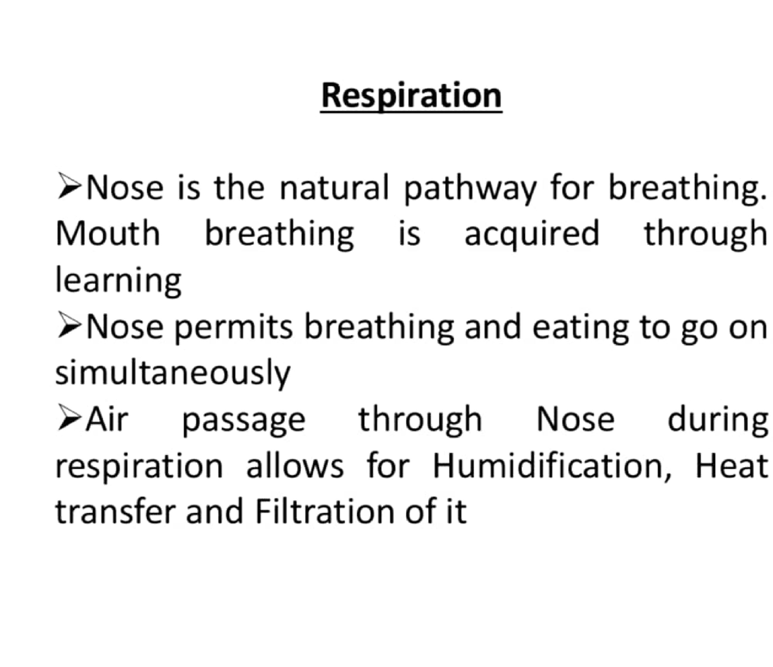

Slide 5
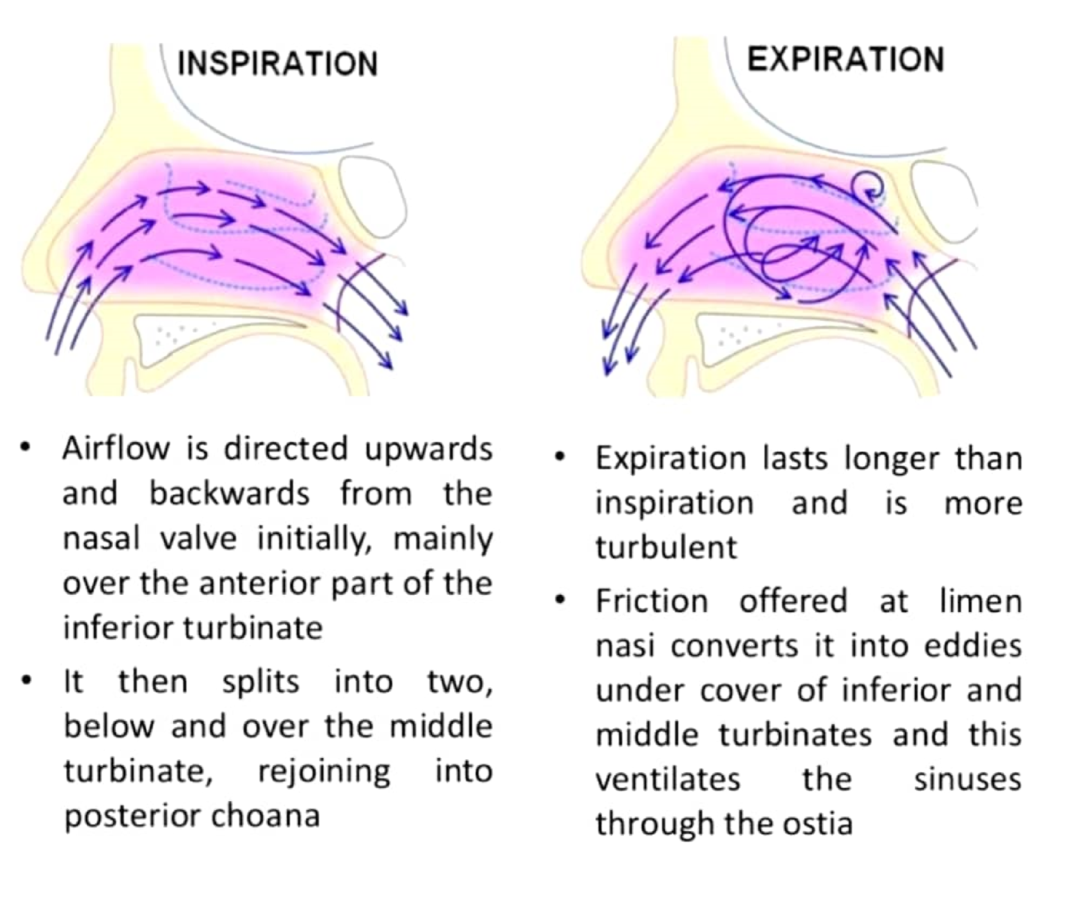

Slide 6
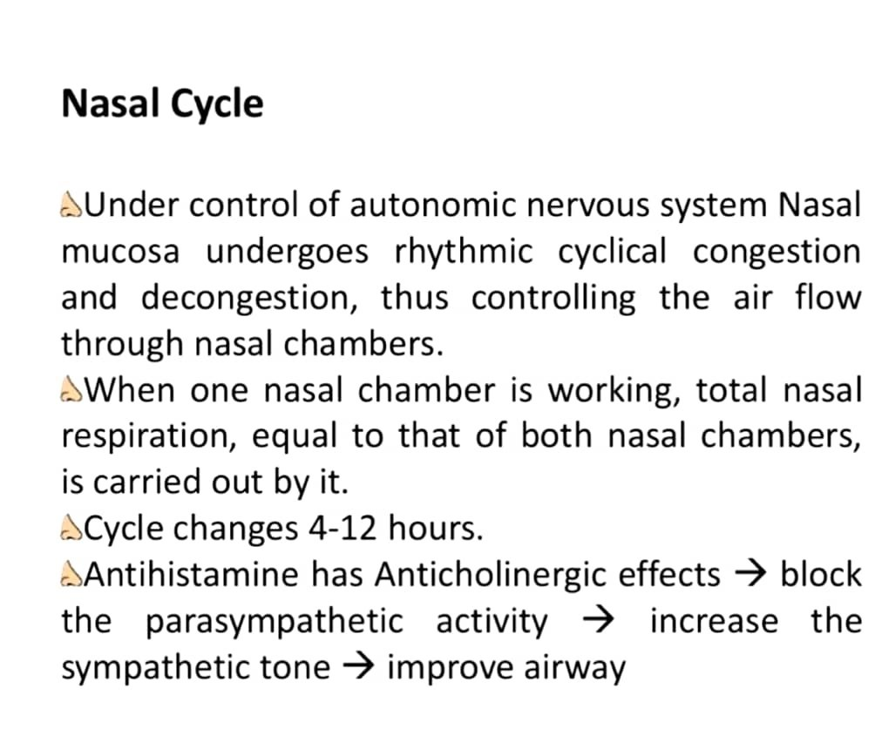

Slide 7
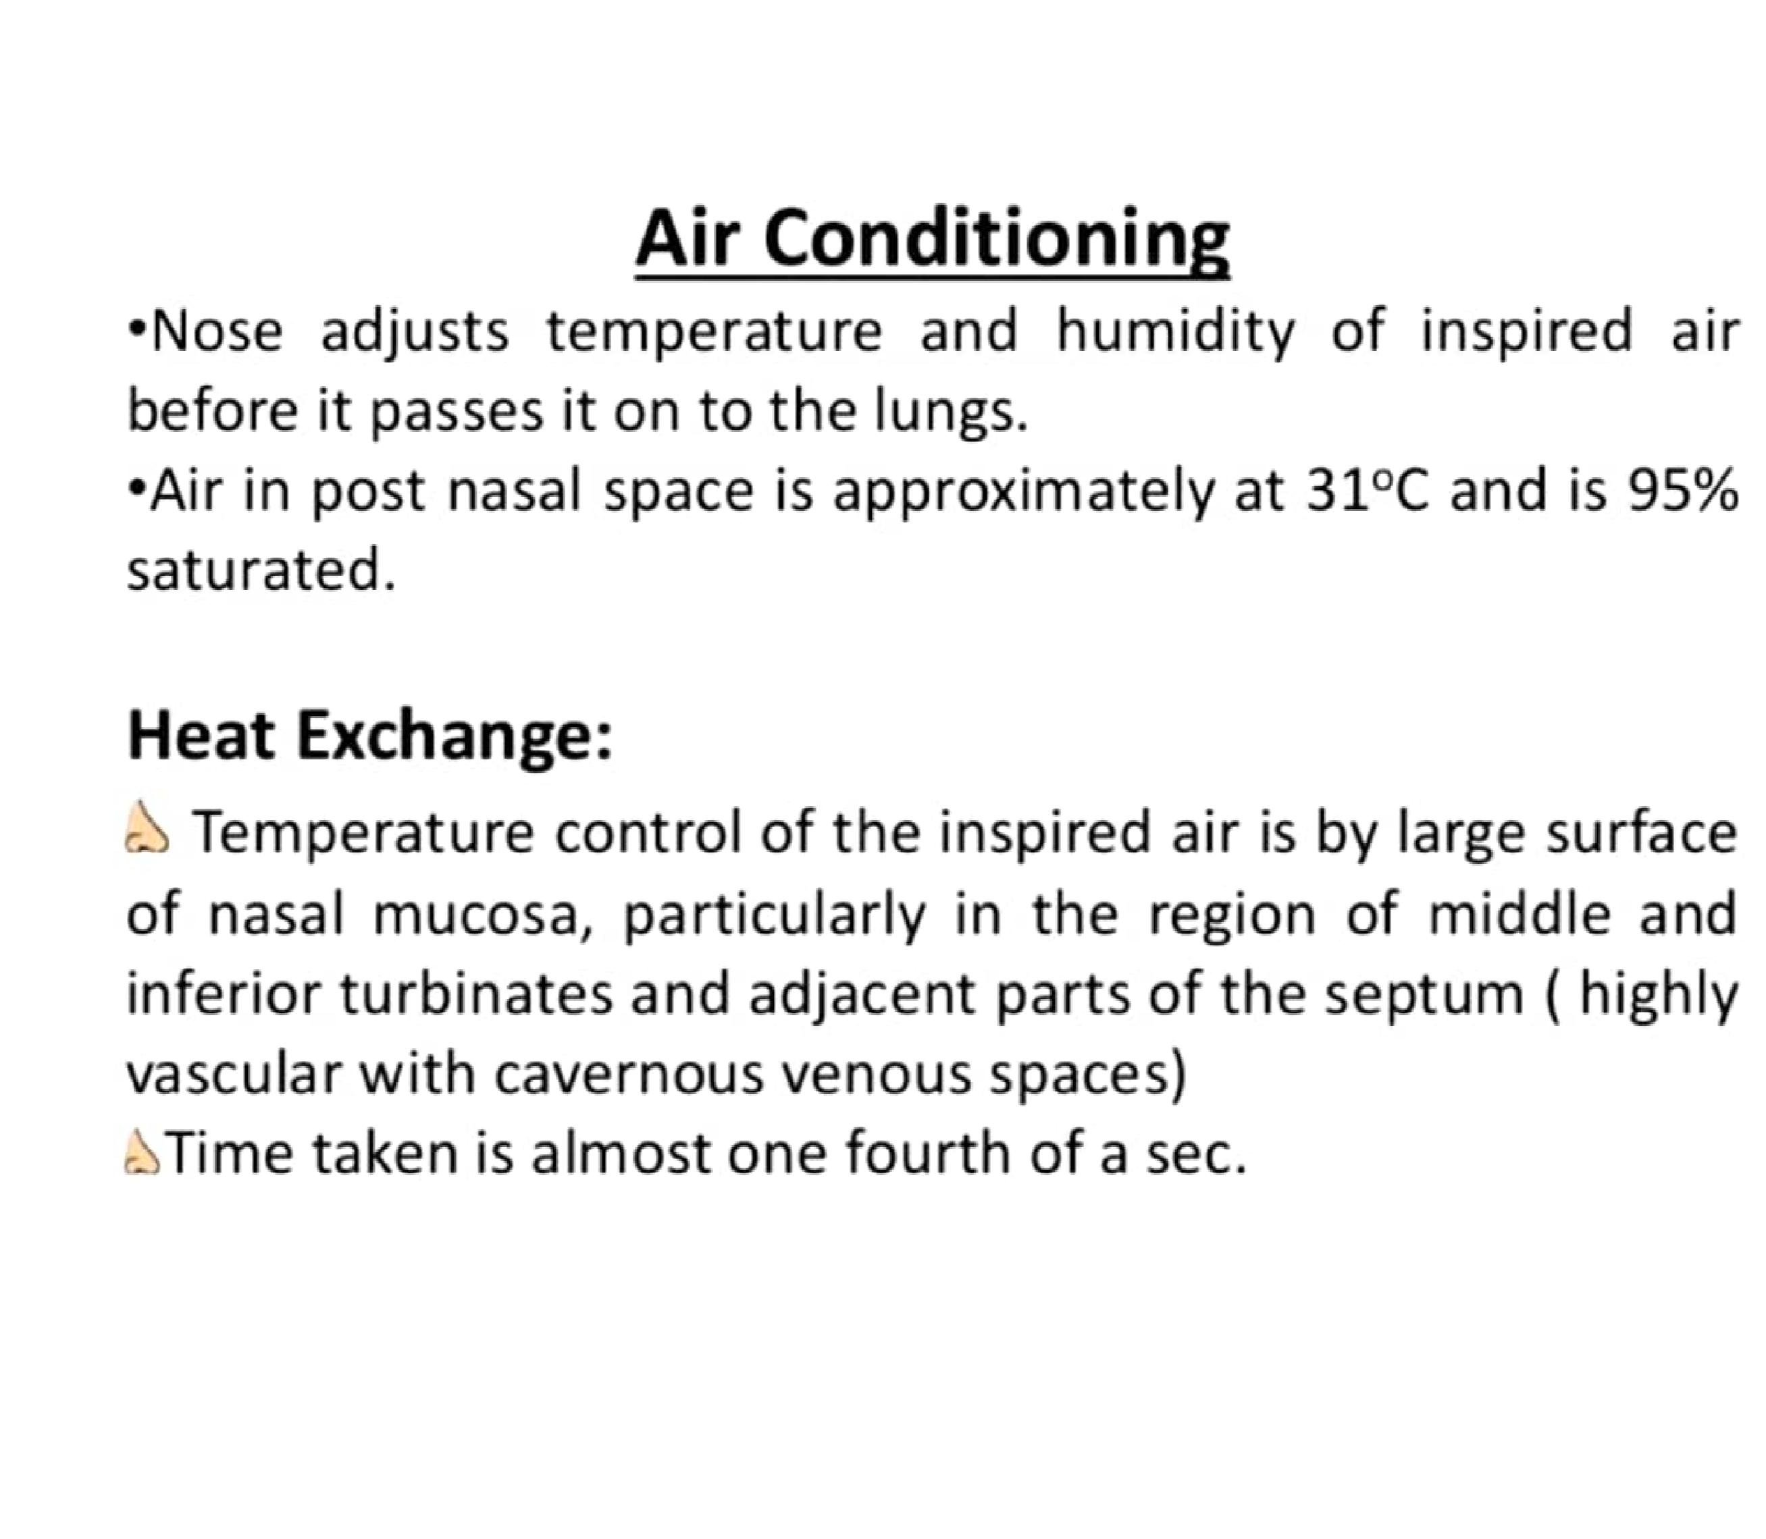

Slide 8
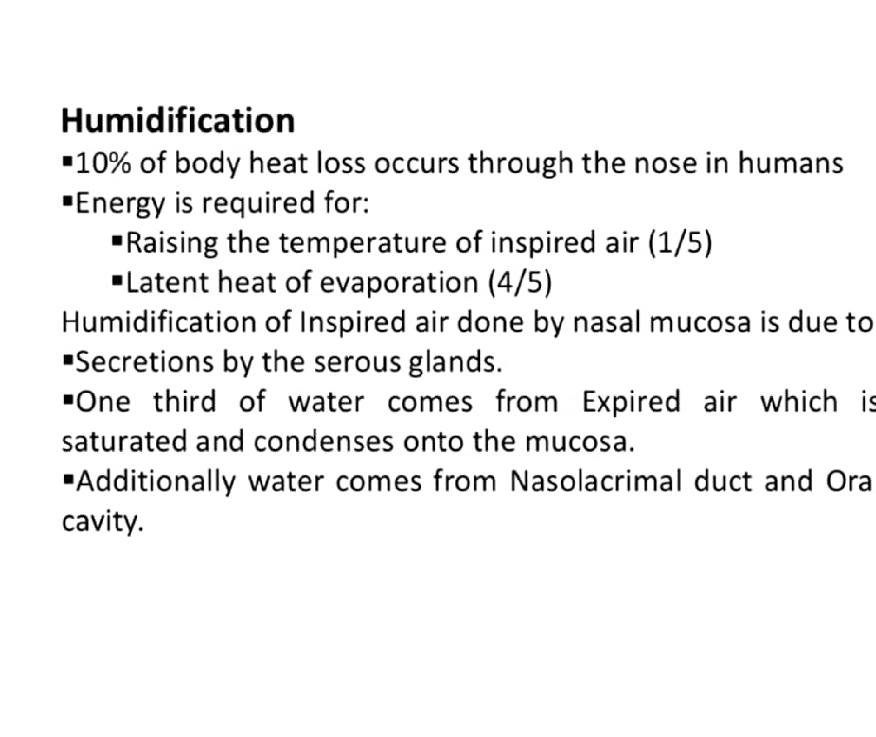

Slide 9
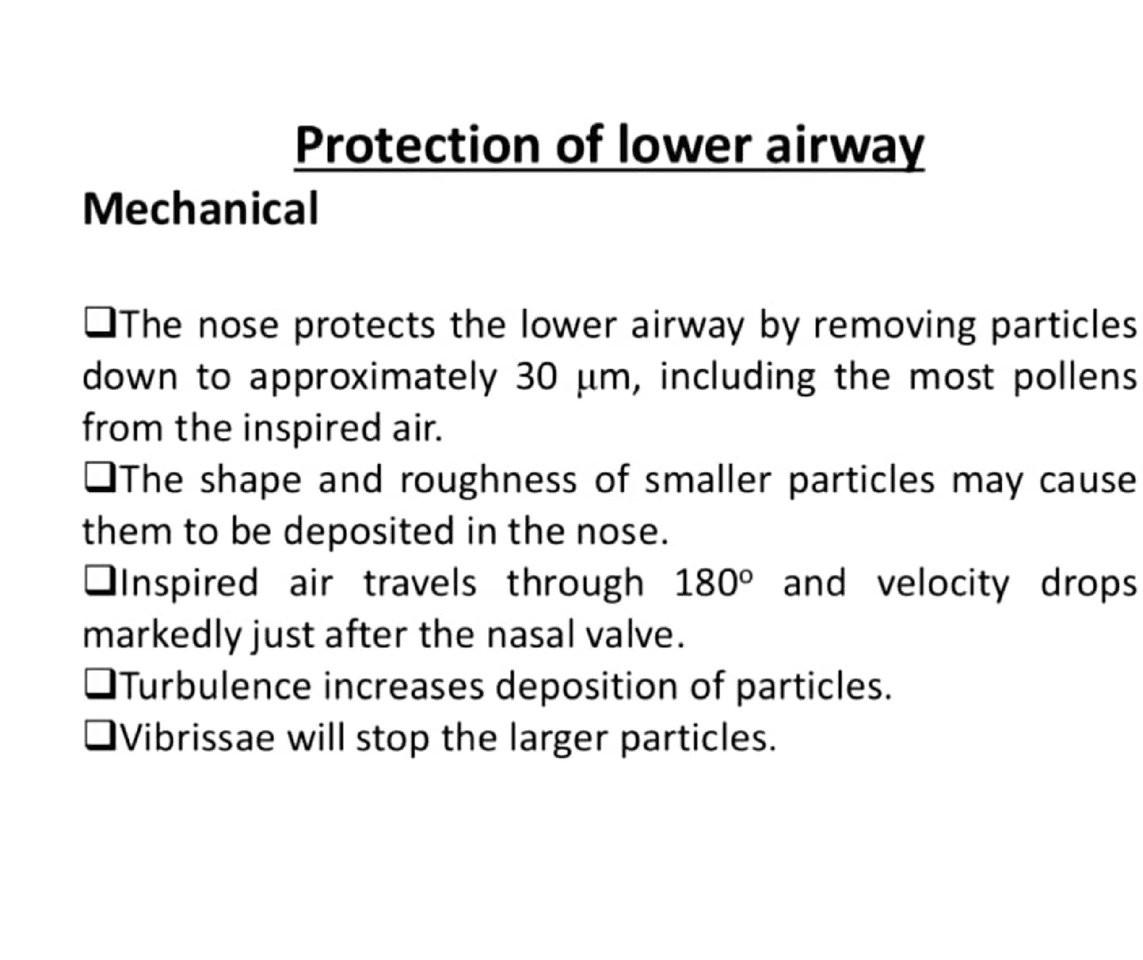

Slide 10
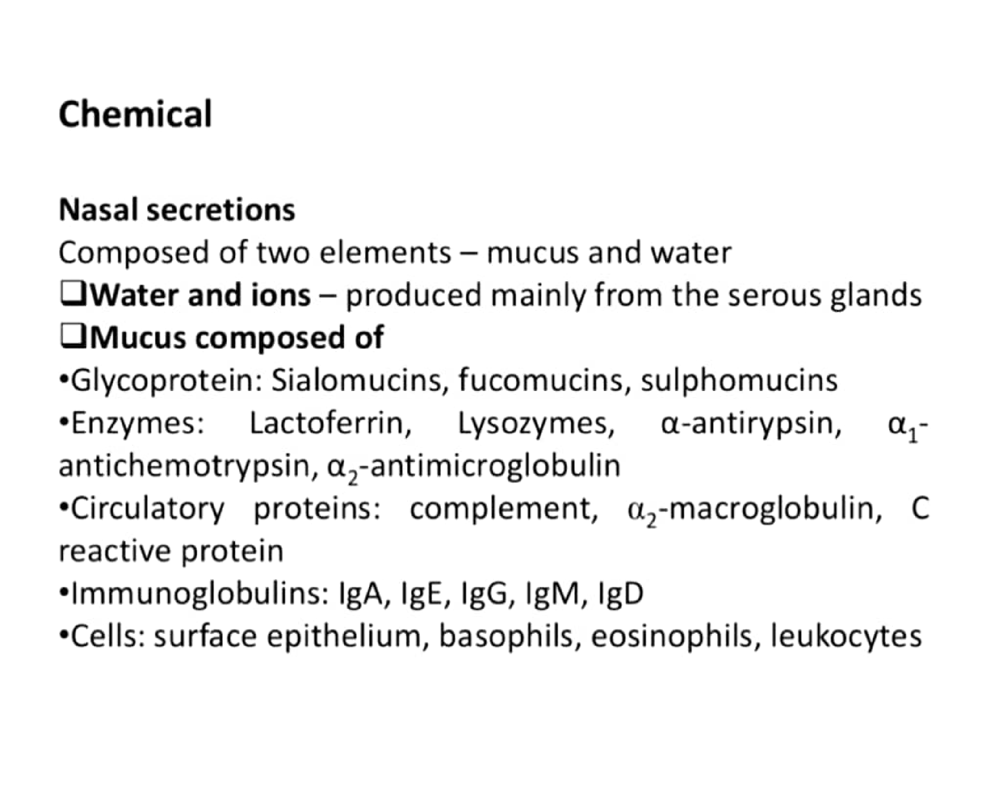

Slide 11
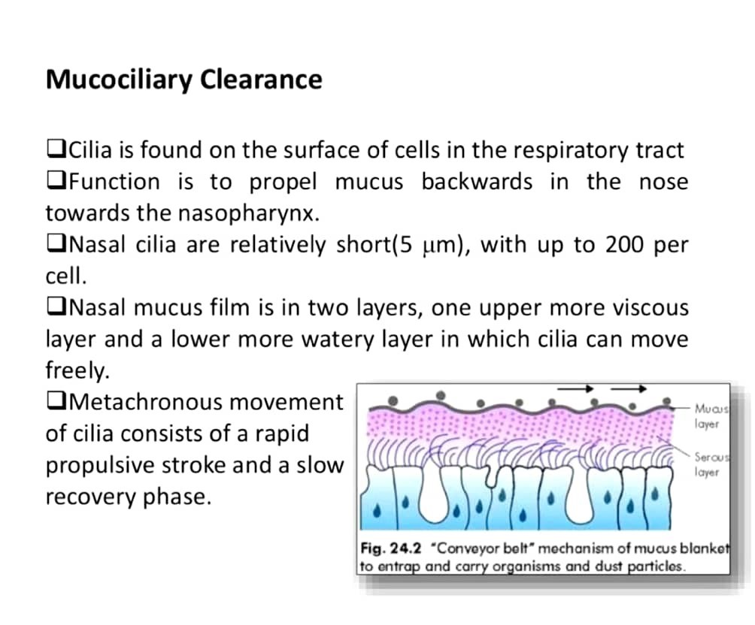

Slide 12
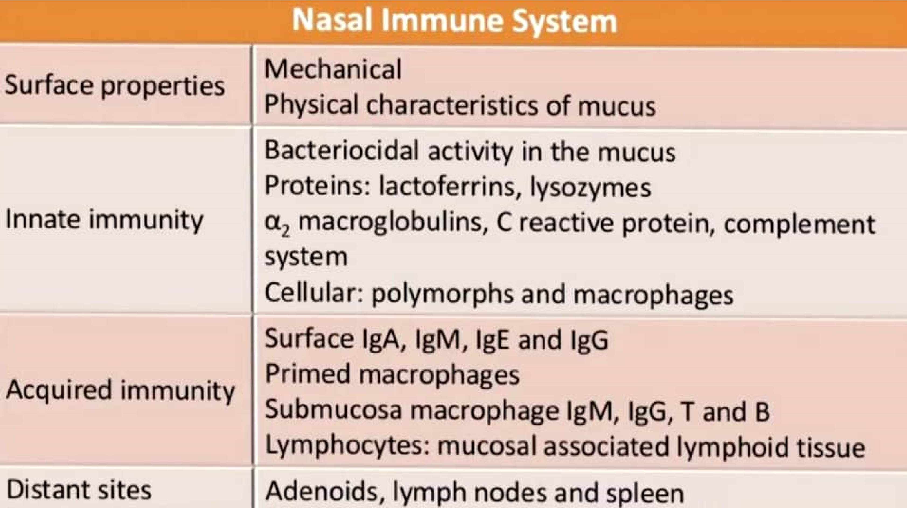

Slide 13
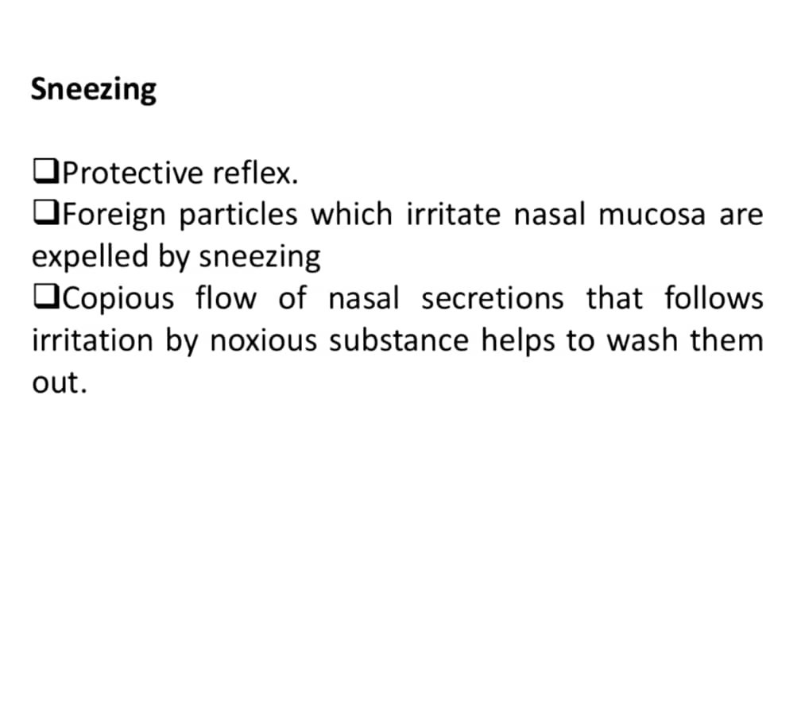

Slide 14
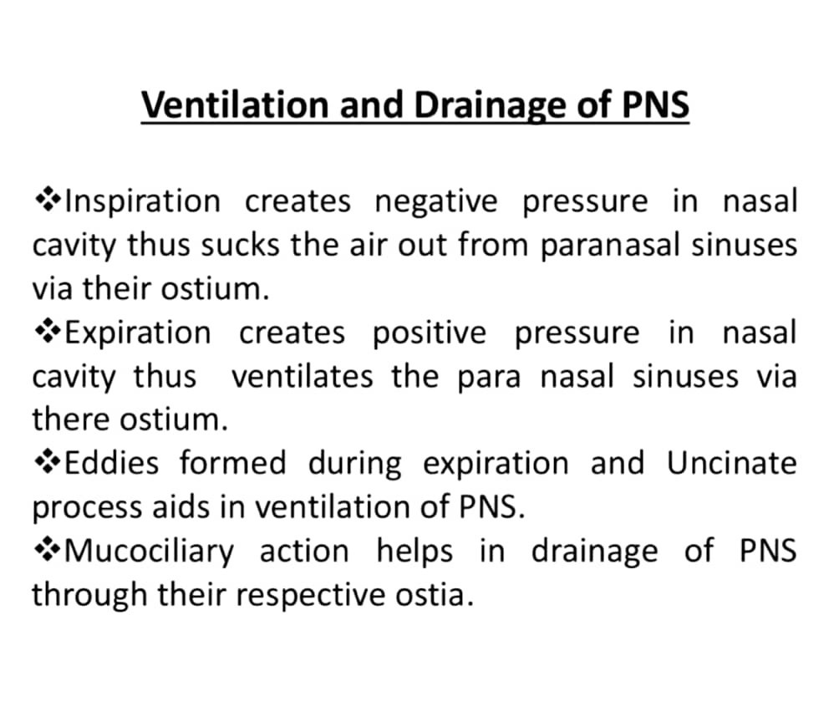

Slide 15
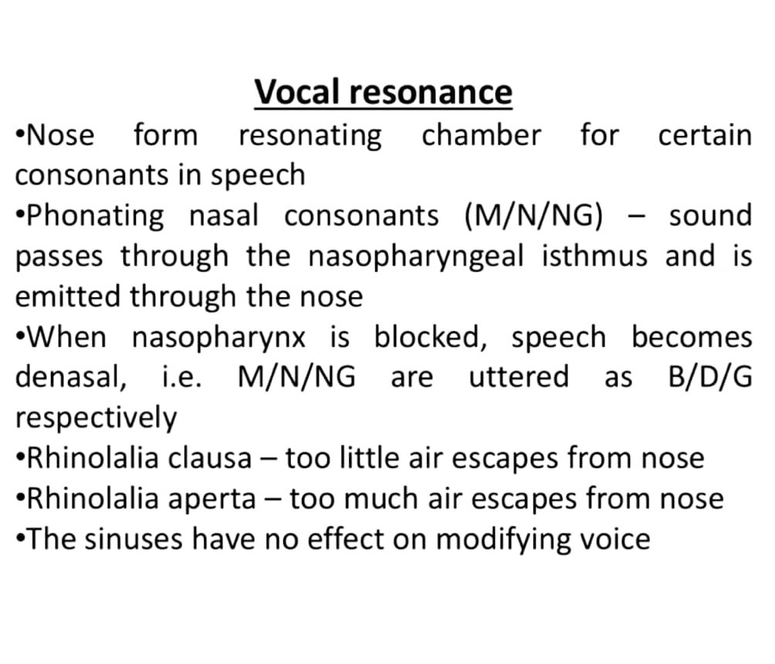

Slide 16
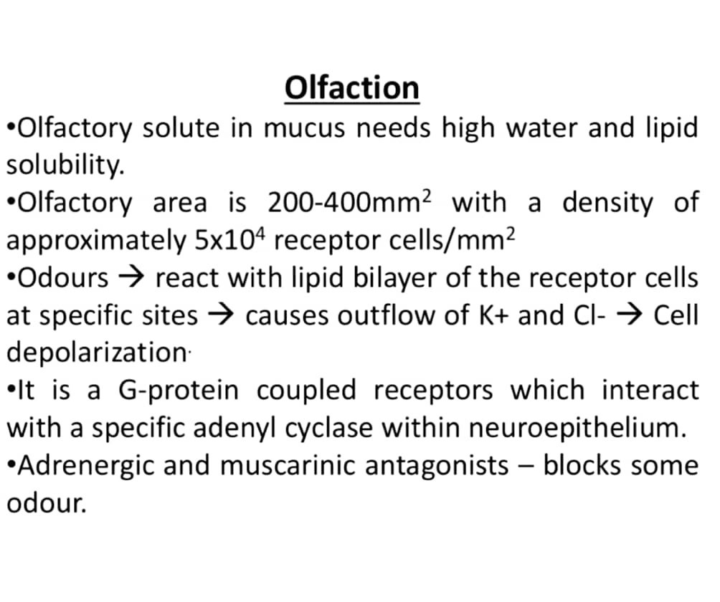

Slide 17
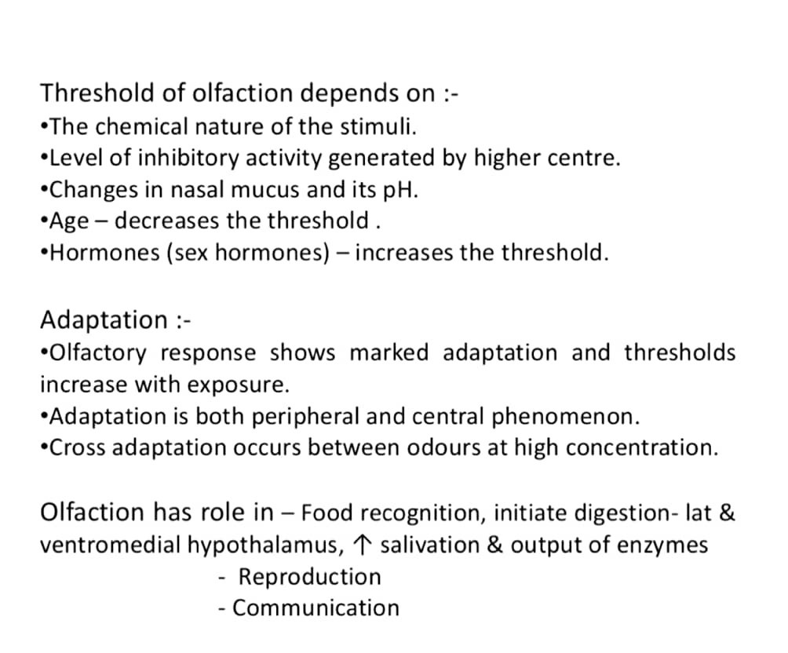

Slide 18
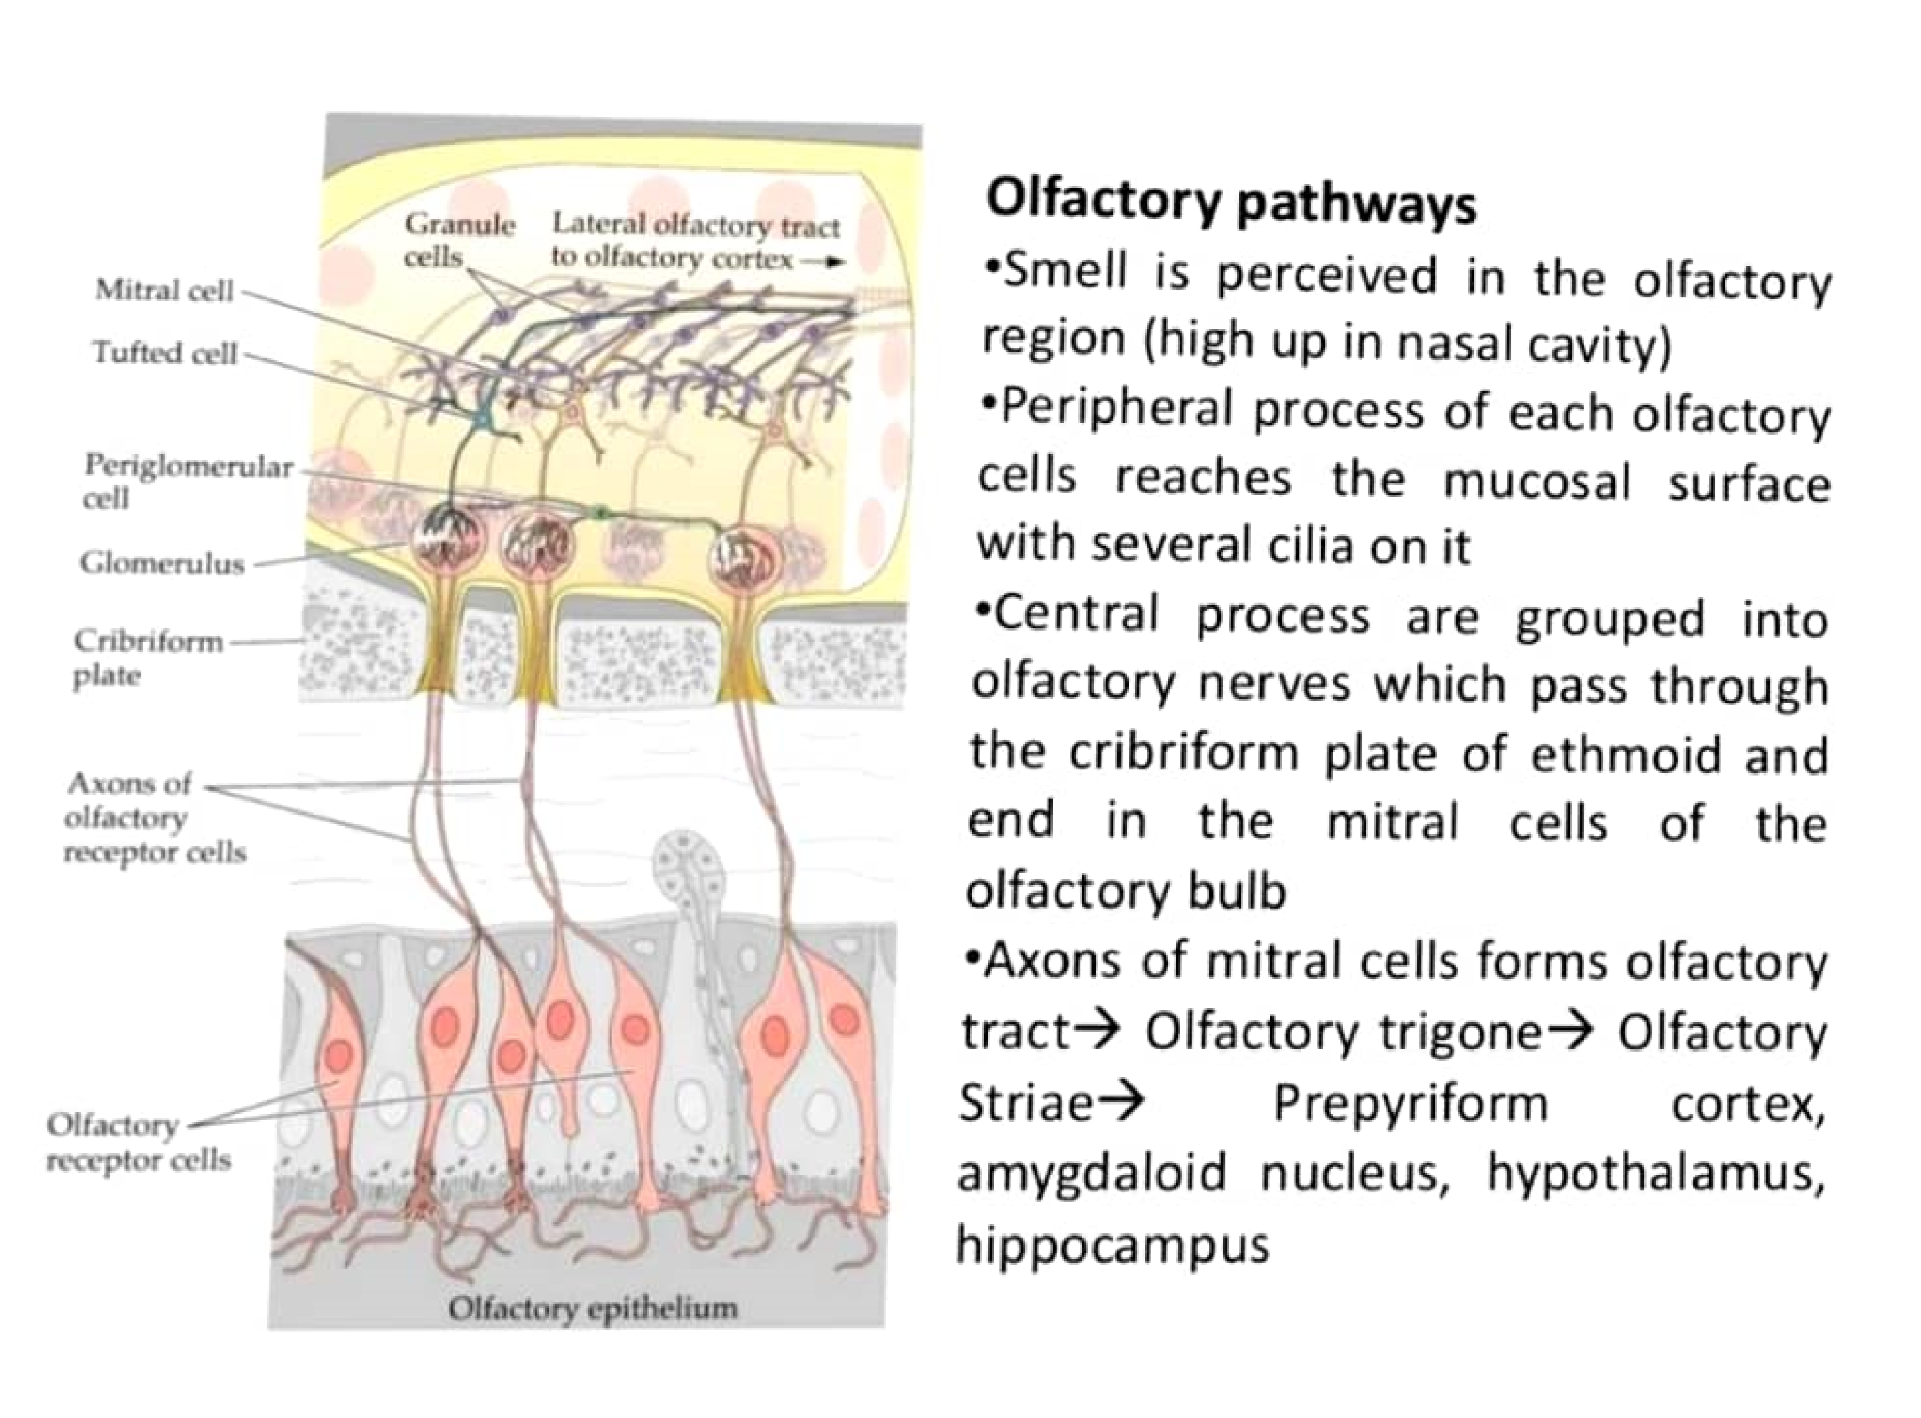

Slide 19
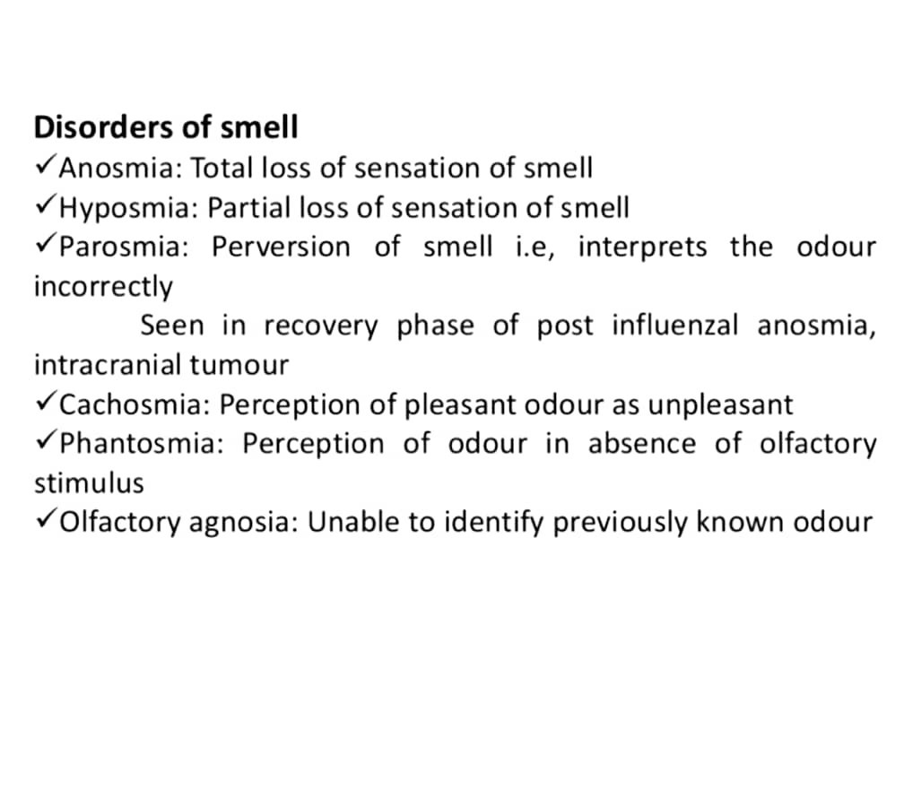

Slide 20

.

Slide 21
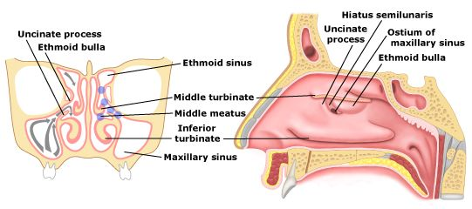
Ostiomeatal complex

Slide 22
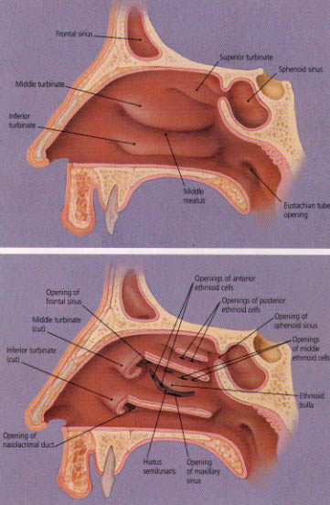
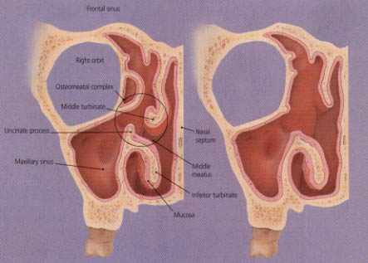
Ostio-meatal Complex (OMC)

Slide 23
Mucosa
Respiratory area
Pseudo stratified ciliated columnar epithelium
Mucous glands and goblet cells
Olfactory area
Vestibule
Skin
Turbinates: Vasular with submucosal sinusoids (Cavernous tissue)

Slide 24
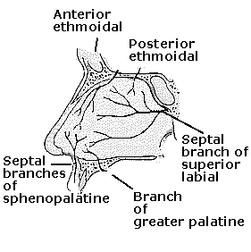
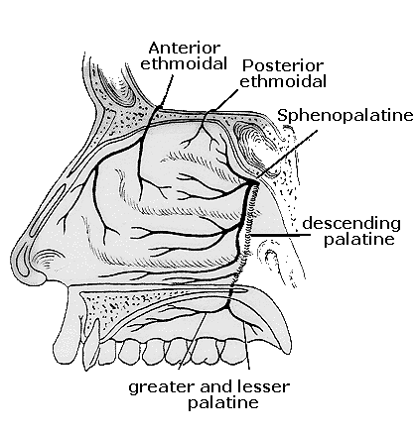
Blood supply

Slide 25
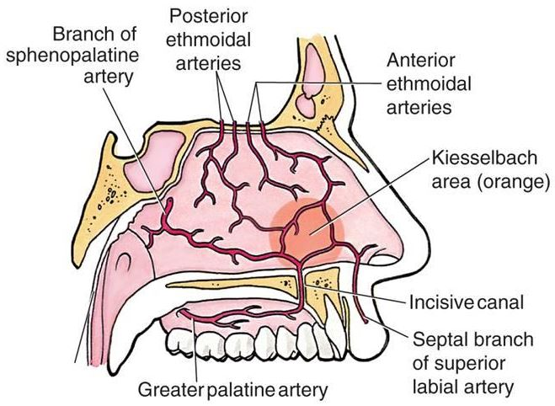
Little area of nose

Slide 26
Little’s area
Caudal part of the nasal septum which has a rich submucosal arterial network: Septal branches of
Anterior ethmoidal
Sphenopalatine
Greater palatine
Superior labial
Prone for drying effect of inspired air and to microtrauma due to picking of the nose
Commonest cause and site of epistaxis in children
DD: Bleeding from retrocolumellar vein

Slide 27
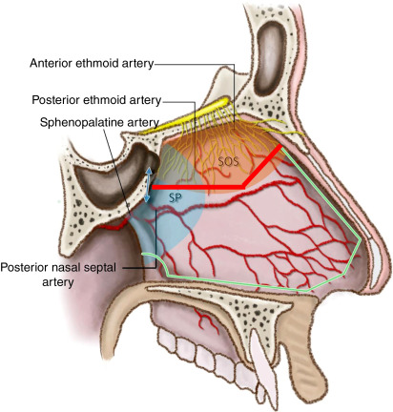
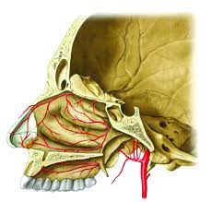
Sphenopalatine artery is considered as THE artery of epistaxis

Slide 28
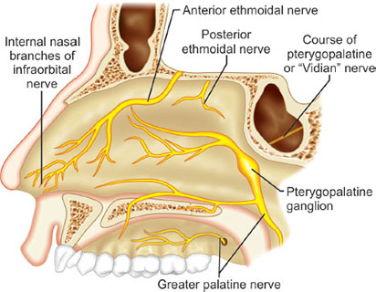
Nerve supply
Maxillary N
Sphenopalatine
Lesser and greater palatine
Anterior ethmoidal N
Olfactory
Autonomic- Vidian N

Slide 29
Lymphatic drainage
Anterior part
Submandibular lymph nodes
Posterior part
Retropharyngeal lymph nodes
Jugulo-digastric lymph nodes

Slide 30
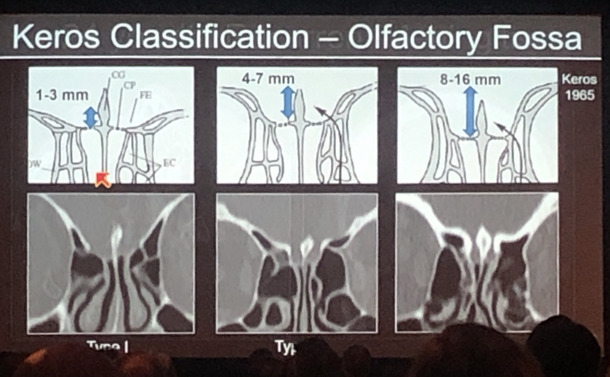
Keros classification

Slide 31
Self assessment
Question: 1
Paired nasal bones are?
Maxilla
Frontal bone
Nasal bone
Middle turbinate
Inferior turbinate

Slide 32
Self assessment
Question: 2
Which of the following open into the middle meatus?
Nasolacrimal duct
Anterior ethmoidal
Posterior ethmoidal
Frontal
sphenoid

Slide 33


